Slide 1
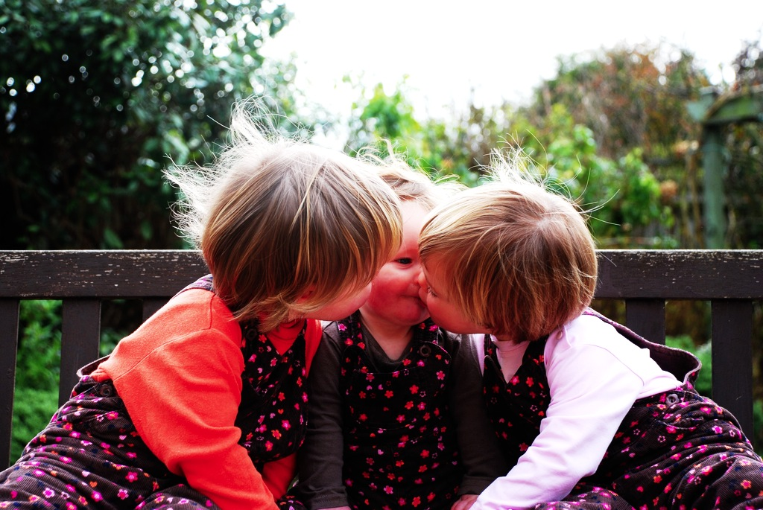

How to construct a
Minimal Theory of Mind

Slide 2
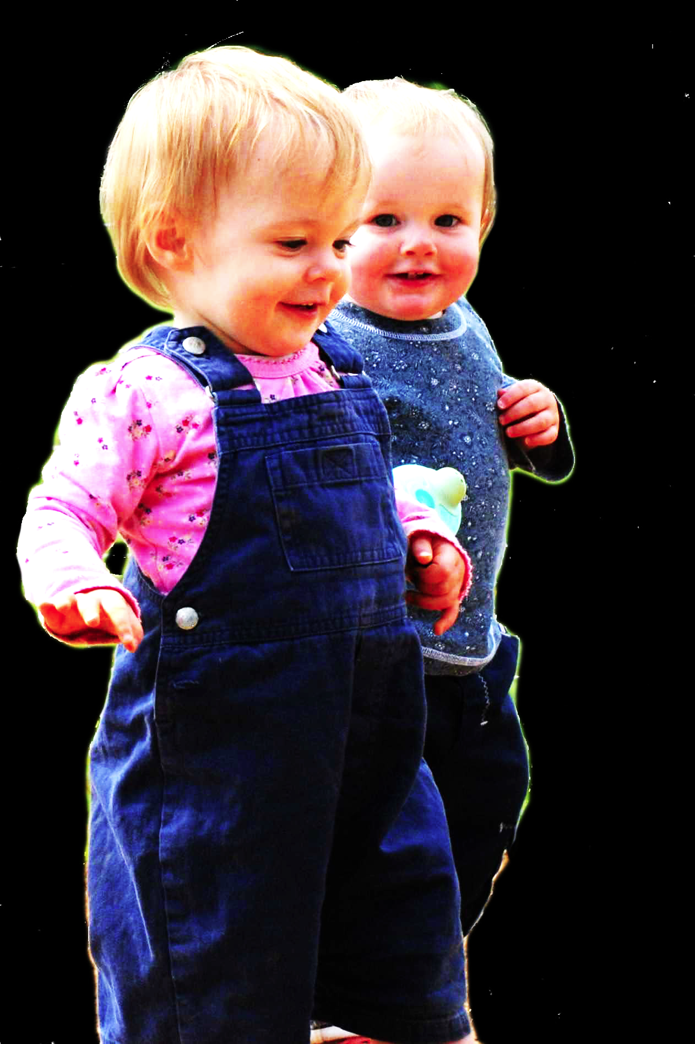
challenge
Explain the emergence, in evolution or development, of full-blown theory of mind cognition.

Slide 3
challenge
Explain the emergence, in evolution or development, of full-blown theory of mind cognition.
conjecture
We need to understand how theory of mind cognition could come in degrees.

Slide 4


“chimpanzees understand … intentions … perception and knowledge … Moreover, they understand how these psychological states work together to produce intentional action”
(Call & Tomasello 2008:191)

Slide 5
“chimpanzees understand … intentions … perception and knowledge … Moreover, they understand how these psychological states work together to produce intentional action”
(Call & Tomasello 2008:191)
“chimpanzees probably do not understand others in terms of a fully human-like belief–desire psychology”
(Call and Tomasello 2008)

Slide 6
“chimpanzees understand … intentions … perception and knowledge … Moreover, they understand how these psychological states work together to produce intentional action”
(Call & Tomasello 2008:191)
“chimpanzees probably do not understand others in terms of a fully human-like belief–desire psychology”
(Call and Tomasello 2008)

Slide 7

“chimpanzees understand … intentions … perception and knowledge … Moreover, they understand how these psychological states work together to produce intentional action”
(Call & Tomasello 2008:191)
“our [typical adult humans’] fundamental conception of what it is to know that P is itself an explanatory conception […] we think of S’s knowledge that P as something that can properly be explained by reference to what S has perceived or remembered or proved or ...”
(Cassam 2007: 356)

Slide 8
challenge
Explain the emergence, in evolution or development, of full-blown theory of mind cognition.
conjecture
We need to understand how theory of mind cognition could come in degrees.

Slide 9
challenge
Explain the emergence, in evolution or development, of full-blown theory of mind cognition.
conjecture
We need to understand how theory of mind cognition could come in degrees.
obstacle
Grasp of everyday psychological concepts like belief, desire, knowledge and intention is all-or-nothing.

Slide 10
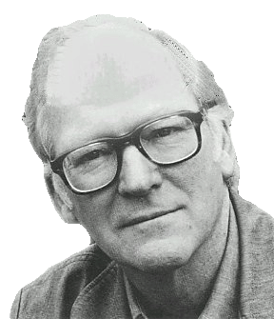
“We are stuck with our two main ways of describing and explaining things, one which treats objects and events as mindless, and the other which treats objects and events as having propositional attitudes. I see no way of bridging the gap”
(Davidson 2003: 697)

Slide 11
“We are stuck with our two main ways of describing and explaining things, one which treats objects and events as mindless, and the other which treats objects and events as having propositional attitudes. I see no way of bridging the gap”
(Davidson 2003: 697)

Slide 12
challenge
Explain the emergence, in evolution or development, of full-blown theory of mind cognition.
conjecture
We need to understand how theory of mind cognition could come in degrees.
obstacle
Grasp of everyday psychological concepts like belief, desire, knowledge and intention is all-or-nothing.

Slide 13
puzzle

Slide 14

Theory of mind abilities are widespread

Slide 15
Theory of mind abilities are widespread
18-month-olds point to inform, and predict actions based on false beliefs
(Liszkowski et al 2006)
(Onishi & Baillargeon 2005; Southgate et al 2007)

Slide 16
Theory of mind abilities are widespread
18-month-olds point to inform, and predict actions based on false beliefs
Scrub-jays selectively re-cache their food in ways that deprive competitors of knowledge of its location
(Liszkowski et al 2006)
(Onishi & Baillargeon 2005; Southgate et al 2007)
(Clayton, Dally & Emery 2007)

Slide 17
Theory of mind abilities are widespread
18-month-olds point to inform, and predict actions based on false beliefs
Scrub-jays selectively re-cache their food in ways that deprive competitors of knowledge of its location
Chimpanzees conceal their approach from a competitor’s view, and act in ways that are optimal given what another has seen
(Liszkowski et al 2006)
(Onishi & Baillargeon 2005; Southgate et al 2007)
(Clayton, Dally & Emery 2007)
(Hare, Call & Tomasello 2006)
(Hare, Call & Tomasello 2001)

Slide 18
Theory of mind abilities are widespread
18-month-olds point to inform, and predict actions based on false beliefs
Scrub-jays selectively re-cache their food in ways that deprive competitors of knowledge of its location
Chimpanzees conceal their approach from a competitor’s view, and act in ways that are optimal given what another has seen
(Liszkowski et al 2006)
(Onishi & Baillargeon 2005; Southgate et al 2007)
(Clayton, Dally & Emery 2007)
(Hare, Call & Tomasello 2006)
(Hare, Call & Tomasello 2001)

Slide 19
Theory of mind abilities are widespread
18-month-olds point to inform, and predict actions based on false beliefs
Scrub-jays selectively re-cache their food in ways that deprive competitors of knowledge of its location
Chimpanzees conceal their approach from a competitor’s view, and act in ways that are optimal given what another has seen
(Liszkowski et al 2006)
(Onishi & Baillargeon 2005; Southgate et al 2007)
(Clayton, Dally & Emery 2007)
(Hare, Call & Tomasello 2006)
(Hare, Call & Tomasello 2001)

Slide 20
Theory of mind abilities are widespread
18-month-olds point to inform, and predict actions based on false beliefs
Scrub-jays selectively re-cache their food in ways that deprive competitors of knowledge of its location
Chimpanzees conceal their approach from a competitor’s view, and act in ways that are optimal given what another has seen
Representing perceptions, knowledge states and beliefs is hard

Slide 21
Theory of mind abilities are widespread
18-month-olds point to inform, and predict actions based on false beliefs
Scrub-jays selectively re-cache their food in ways that deprive competitors of knowledge of its location
Chimpanzees conceal their approach from a competitor’s view, and act in ways that are optimal given what another has seen
Representing perceptions, knowledge states and beliefs is hard, for it requires
(a) conceptual sophistication
- takes years to develop
- development tied to acquisition of executive function and language
- development facilitated by training and siblings

Slide 22
Theory of mind abilities are widespread
18-month-olds point to inform, and predict actions based on false beliefs
Scrub-jays selectively re-cache their food in ways that deprive competitors of knowledge of its location
Chimpanzees conceal their approach from a competitor’s view, and act in ways that are optimal given what another has seen
Representing perceptions, knowledge states and beliefs is hard, for it requires
(a) conceptual sophistication
- takes years to develop
- development tied to acquisition of executive function and language
- development facilitated by training and siblings
(b) scarce cognitive resources
- attention
- working memory

Slide 23
Theory of mind abilities are widespread
18-month-olds point to inform, and predict actions based on false beliefs
Scrub-jays selectively re-cache their food in ways that deprive competitors of knowledge of its location
Chimpanzees conceal their approach from a competitor’s view, and act in ways that are optimal given what another has seen
Representing perceptions, knowledge states and beliefs is hard, for it requires
(a) conceptual sophistication
- takes years to develop
- development tied to acquisition of executive function and language
- development facilitated by training and siblings
(b) scarce cognitive resources
- attention
- working memory

Slide 24
Propositional attitudes …
cause actions
resemble “intervening variables” linking environment to behaviour
have contents which may be true or false
have contents which may refer to non-existent entities
are involved in uncodifiably complex causal interactions
have contents which are individuated by senses, not only by referents
are associated with normative requirements
are indviduated in terms of their interlocking roles in causal and normative explanations of thought and action
…

Slide 25
puzzle
What could infants, chimps and scrub-jays represent that would enable them, within limits, to track others’ perceptions, knowledge, beliefs and other propositional attitudes?

Slide 26
puzzle
What could infants, chimps and scrub-jays represent that would enable them, within limits, to track others’ perceptions, knowledge, beliefs and other propositional attitudes?

Slide 27

puzzle
What could infants, chimps and scrub-jays represent that would enable them, within limits, to track others’ perceptions, knowledge, beliefs and other propositional attitudes?

Slide 28
puzzle
What could infants, chimps and scrub-jays represent that would enable them, within limits, to track others’ perceptions, knowledge, beliefs and other propositional attitudes?

Slide 29
puzzle
What could infants, chimps and scrub-jays represent that would enable them, within limits, to track others’ perceptions, knowledge, beliefs and other propositional attitudes?

Slide 30
puzzle
What could infants, chimps and scrub-jays represent that would enable them, within limits, to track others’ perceptions, knowledge, beliefs and other propositional attitudes?

Slide 31
puzzle
What could infants, chimps and scrub-jays represent that would enable them, within limits, to track others’ perceptions, knowledge, beliefs and other propositional attitudes?

Slide 32
puzzle
What could infants, chimps and scrub-jays represent that would enable them, within limits, to track others’ perceptions, knowledge, beliefs and other propositional attitudes?

Slide 33
puzzle
What could infants, chimps and scrub-jays represent that would enable them, within limits, to track others’ perceptions, knowledge, beliefs and other propositional attitudes?

Slide 34
puzzle
What could infants, chimps and scrub-jays represent that would enable them, within limits, to track others’ perceptions, knowledge, beliefs and other propositional attitudes?

Slide 35
puzzle
What could infants, chimps and scrub-jays represent that would enable them, within limits, to track others’ perceptions, knowledge, beliefs and other propositional attitudes?

Slide 36
Where is the ball?
puzzle
What could infants, chimps and scrub-jays represent that would enable them, within limits, to track others’ perceptions, knowledge, beliefs and other propositional attitudes?

Slide 37
Where is the ball?
puzzle
RT / looing time
What could infants, chimps and scrub-jays represent that would enable them, within limits, to track others’ perceptions, knowledge, beliefs and other propositional attitudes?
Other’s belief True
Other’s belief False

Slide 38




puzzle
What could infants, chimps and scrub-jays represent that would enable them, within limits, to track others’ perceptions, knowledge, beliefs and other propositional attitudes?

Slide 39
challenge
Explain the emergence, in evolution or development, of full-blown theory of mind cognition.
puzzle
What could infants, chimps and scrub-jays represent that would enable them, within limits, to track others’ perceptions, knowledge, beliefs and other propositional attitudes?

Slide 40

challenge
Explain the emergence, in evolution or development, of full-blown theory of mind cognition.
puzzle
What could infants, chimps and scrub-jays represent that would enable them, within limits, to track others’ perceptions, knowledge, beliefs and other propositional attitudes?

Slide 41


